Slide 1
SUPPLY CHAIN PERFORMANCE INSIGHTS
BY: STEPHEN CHINENYE ANYALEWECHI

Slide 2
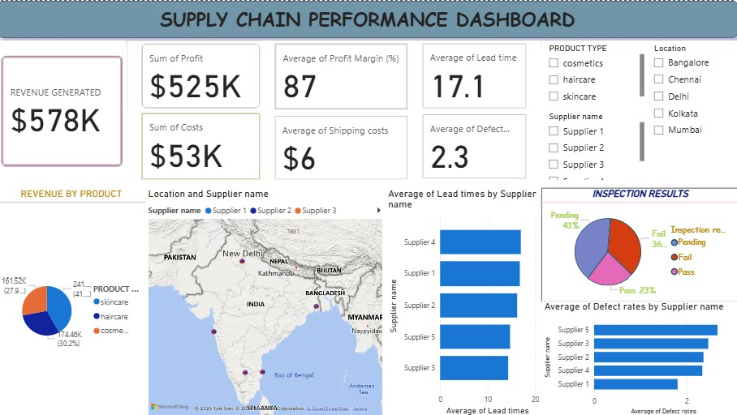
This report provides a high-level overview of our supply chain's financial performance, operational efficiency, quality, and risk factors, as well as customer insights.

Slide 3
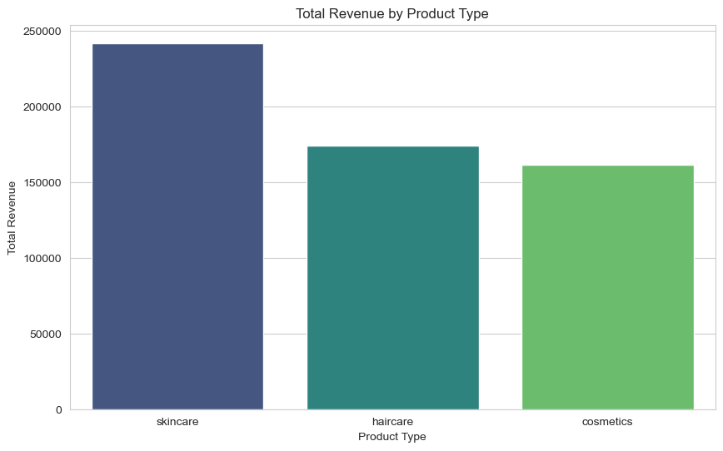
FINANCIAL PERFORMANCE

Slide 4
TOTAL REVENUE AND COSTS
Total Revenue: Approximately $570,000
Total Costs: Around $607.39 (average per SKU)
Average Profit Margin: 88.6% across all SKUs
PRODUCT TYPE VARIATION
All Product Types: Profitable
Highest Average Profit Margins:
Cosmetics: 89.17%
Haircare: 88.75%
Skincare: 87.87%
REVENUE DISTRIBUTION
Skincare Products: Contribute most to total revenue: $250,589.69
Cosmetics: $216,980.82
Haircare: $104,188.08

Slide 5
HIGHEST AND LOWEST PROFIT MARGINS
Highest Profit Margins:
SKU 88 (Cosmetics): 98.89%
SKU 2 (Haircare): 98.51%
SKU 67 (Skincare): 98.21%
Lowest Profit Margins:
SKU 91 (Cosmetics): 48.49%
SKU 75 (Skincare): 53.78%
SKU 10 (Skincare): 65.41%
Action Needed: Investigate for cost reduction or strategic re-evaluation
SHIPPING COSTS IMPACT
Impact on Profit Margins: Shipping costs erode margin
Variability in Shipping Costs: Across carriers and transportation modes
Insights:
Air transport can be comparable to, or lower than, road/rail for certain SKUs
Opportunities for optimization by leveraging carrier strengths and route efficiencies

Slide 6
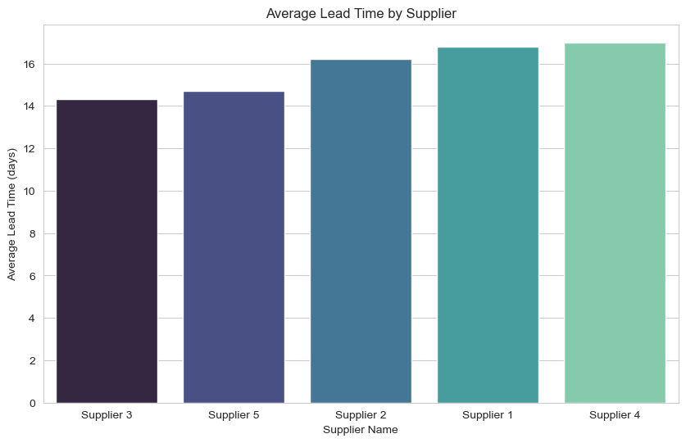
2. OPERATIONAL EFFICIENCY

Slide 7
AVERAGE LEAD AND SHIPPING TIMES
Average Order Lead Time: Approximately 16.5 days.
Average Shipping Time: Around 5.4 days.
BOTTLENECKS/INEFFICIENCIES
Key Bottleneck: Low availability of high-demand products leads to missed sales opportunities.
Low Availability Examples: SKU13: 5%, SKU10: 11%, SKU4: 26%.
Implications: Issues in demand planning, production scheduling, or supplier capacity.
Inconsistent Supplier Lead Times: Ranges from 1 to 30 days, complicating inventory planning.

Slide 8
Most Efficient Suppliers/Carriers (Lead Time & Cost)
Carriers:
Carrier A: Fastest average shipping time (4.61 days), higher costs ($5.48)
Carrier C: Slowest average shipping time (6.13 days), lowest costs ($5.37)
Insight: Trade-off between speed and cost requires a dynamic carrier strategy
Suppliers:
Supplier 4: Lowest average lead time (13.19 days)
Supplier 2: Highest average lead time (19.88 days)
Manufacturing Costs: Vary significantly from $1.59 to $98.60

Slide 9
Stock Levels, Availability, and Sales/Revenue Correlation
Availability vs. Revenue:
No clear linear correlation observed
High revenue generated even with low availability indicates strong demand
Potential for increased revenue if availability improves
Some products with high availability generate lower revenue, suggesting overstocking or lower demand
Stock Levels vs. Products Sold:
Scattered distribution indicates high stock levels do not always correlate with high sales
Reinforces the finding that some SKUs are overstocked relative to demand, tying up capital

Slide 10
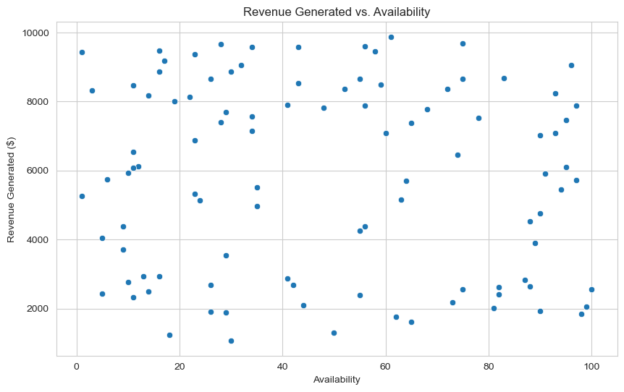
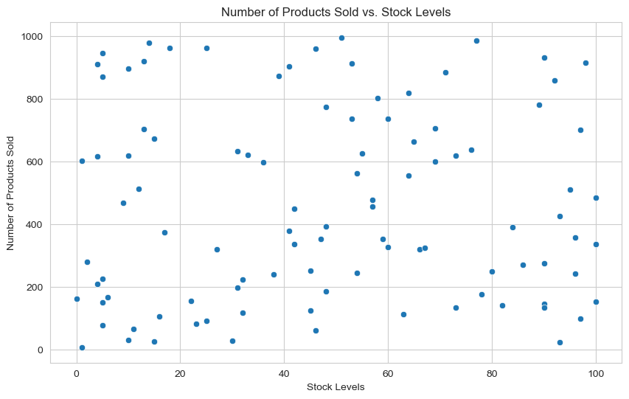
Stock Levels, Availability, and Sales/Revenue Correlation

Slide 11
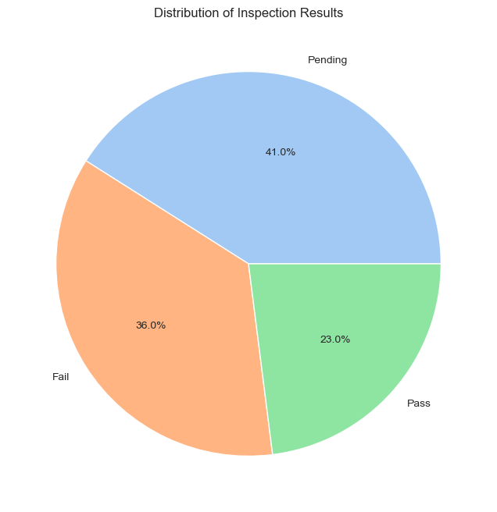
3. QUALITY AND RISKS

Slide 12
Overall Defect Rate
Average Defect Rate: Approximately 2.2% across all products.
Specific Products/Suppliers/Locations
Concentration of Quality Issues:
Skincare Products: Notably higher defect rates.
Supplier 5: Particularly from its Kolkata location, has multiple SKUs with elevated defect rates.
Example Defect Rates:
SKU1 (Skincare): 4.85%
SKU3: 4.74%
SKU65: 4.91%
"Fail" vs. "Pass" Inspection Results
Inconsistencies Observed:
Some products that "Pass" inspection still exhibit non-zero defect rates.
Examples:
SKU10: 1.72% defect rate,
SKU15: 2.26% defect rate
Implication: Current inspection criteria may be too lenient or misaligned with actual product quality, allowing defective products to reach customers.

Slide 13
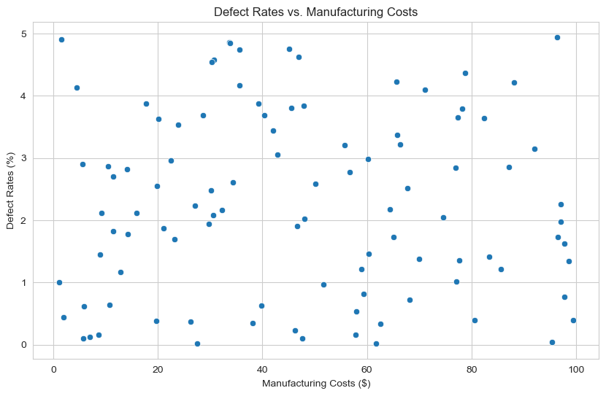
Correlations between Manufacturing Costs, Production Volumes, and Defect Rates
Defect Rates vs. Manufacturing Costs:
No strong linear correlation observed.
High manufacturing costs do not guarantee low defect rates and vice versa.

Slide 14
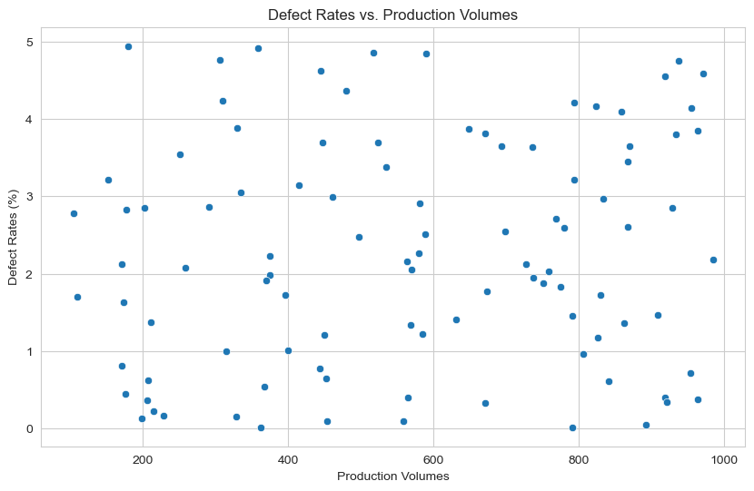
Correlations between Manufacturing Costs, Production Volumes, and Defect Rates
Defect Rates vs. Production Volumes:
No clear correlation found.
High production volumes do not consistently lead to higher or lower defect rates.

Slide 15
SUMMARY ON DEFECT RATES
Key Influences on Defect Rates:
Specific product complexities
Supplier quality control processes
Manufacturing locations
Defect rates appear to be influenced more by these factors rather than solely manufacturing costs or production volumes.

Slide 16
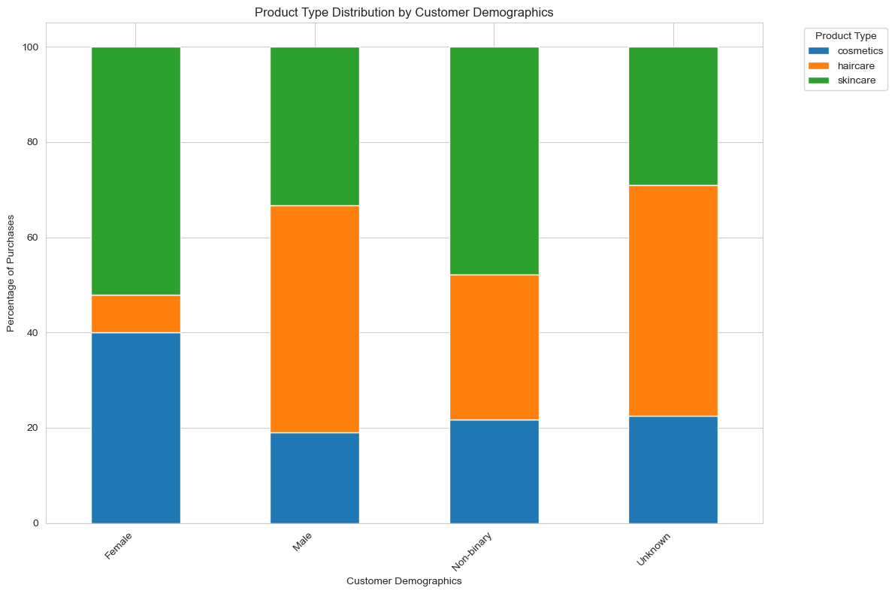
4. CUSTOMER AND MARKET INSIGHTS

Slide 17
Customer Demographics and Product Types
Female Customers
Cosmetics: Approximately 40% of purchases.
Skincare: Approximately 30% of purchases.
Haircare: Approximately 20% of purchases.
Male Customers
Skincare: Approximately 60% of purchases.
Haircare: Approximately 30% of purchases.
Cosmetics: Approximately 20% of purchases.
Non-Binary Customers
Distribution: Relatively even across product types, with Skincare being slightly higher.
Unknown Demographics
Impact: A significant portion of purchases falls under "unknown" demographics, which limits targeted marketing and demand forecasting.
Recommendation: Addressing this data gap is critical for improvement..

Slide 18
B. Most Popular Products for Inventory Planning
Definition of Popular Products: Products with a high number of units sold are considered popular.
Top Selling SKUs
SKU10 (Skincare):
Units Sold: 996
SKU91 (Cosmetics):
Units Sold: 916
SKU98 (Skincare):
Units Sold: 913

Slide 19
Importance for Inventory Planning
Crucial Information: Understanding the sales volume of these products is essential for future inventory planning.
Sufficient Availability: It is vital to ensure that these popular products have adequate stock levels to meet customer demand and prevent lost sales.
Current Challenges
Low Availability: Some high-selling items currently suffer from insufficient stock, which could lead to missed sales opportunities.
Recommendations
Invest in Demand Forecasting: Enhance demand forecasting for these popular items to improve inventory management and ensure that stock levels align with customer demand.

Slide 20
THANK YOU FOR YOUR AUDIENCE!!!

